Slide 1
CoC Unsheltered Special Notice of Funding Opportunity (“SNOFO”) Webinar
Tuesday, August 16 1-2:30 pm
New funding for Critical Supportive Services for Persons Sleeping in Encampments and other Places not Meant for Human Habitation

Slide 2
Sourced from NAEH and HUD

Slide 3
TN 504 Maximum Award
The HUD CoC Unsheltered Homelessness Set Aside Maximum Award Amount for the Metropolitan Nashville-Davidson County Continuum of Care (TN 504) totals $4,855,000 for three years.

Slide 4
The purpose of this NOFO is to target efforts to reduce unsheltered homelessness, especially in communities with very high numbers of people experiencing unsheltered homelessness and rural homelessness.
This NOFO will assist CoCs in reducing homelessness among people with severe service needs, especially people with histories of unsheltered homelessness.
CoCs must demonstrate a comprehensive, coordinated approach to reducing unsheltered homelessness. This approach should be grounded in Housing First and public health principles. This includes improving service engagement, health outcomes, and housing stability among highly vulnerable unsheltered individuals and families.
The CoC’s comprehensive approach should advance equity and demonstrate involvement of individuals with lived experience of homelessness in service delivery and decision making.
The CoC’s comprehensive approach should include partnership with health and housing agencies to leverage mainstream housing and healthcare resources. These partnerships should support the Housing First and public health principles defined above.

Slide 9
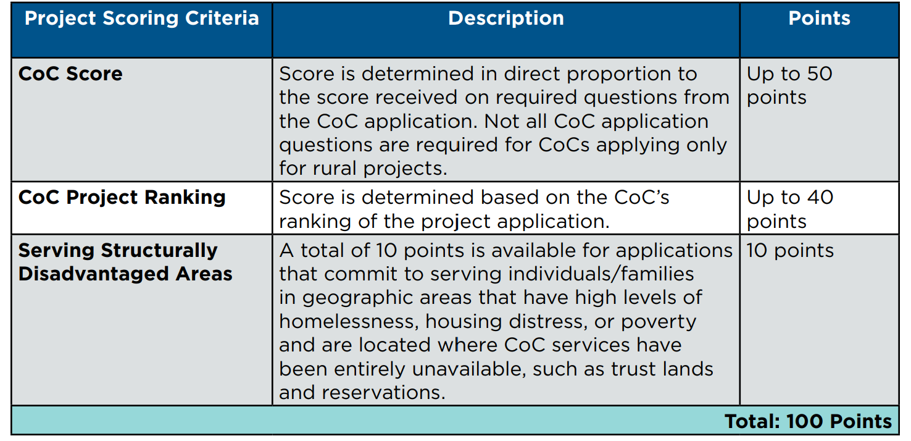
Project Application Scoring - Unsheltered Homelessness Set Aside – CoCs will be selected for funding, including all rated and ranked projects that pass threshold until funding runs out.

Slide 10
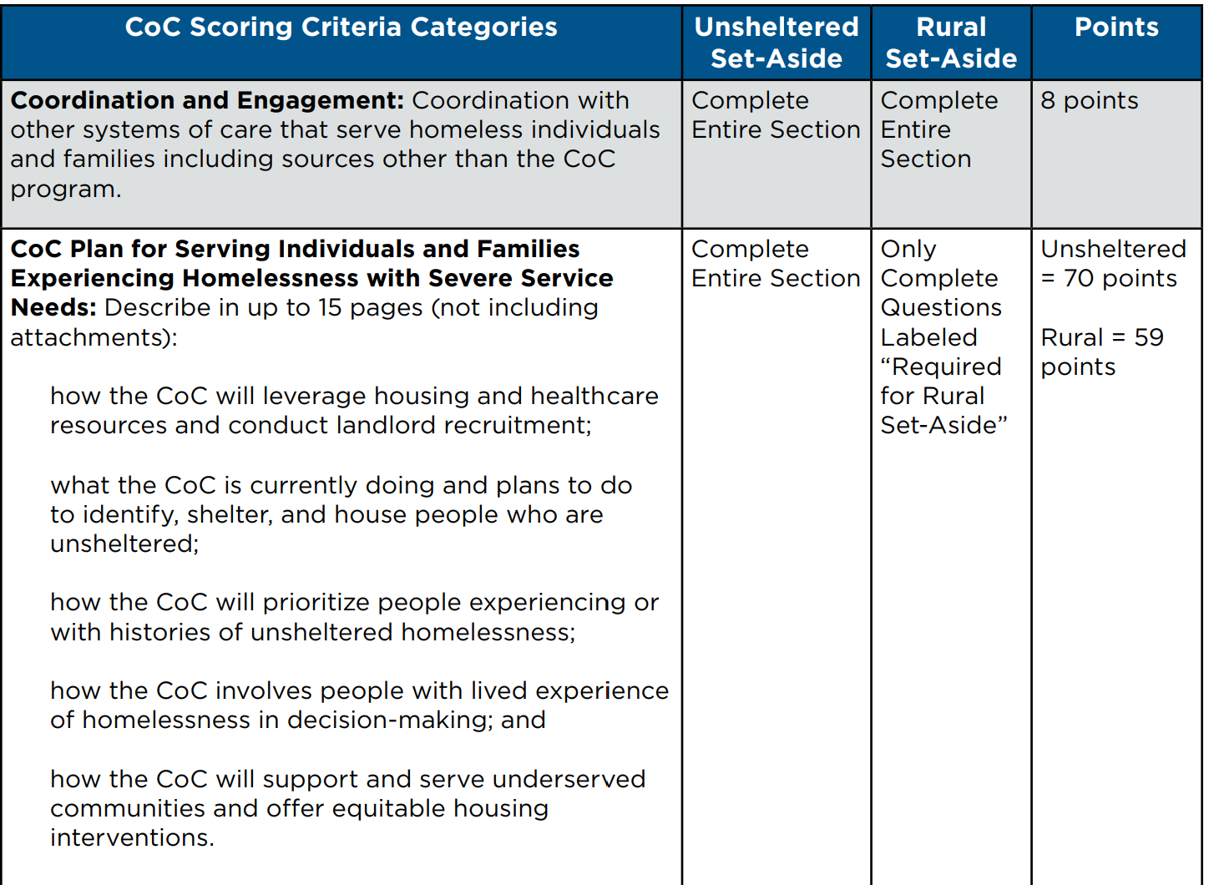

Slide 13
What HUD is Looking for in Community Responses - System Level Elements
Continuously advance best practices
Streamline the delivery of assistance
Leverage the expertise of people who have experienced homelessness
Advance equity in service design and delivery
Utilize local data and measure outcomes

Slide 14
What HUD is Looking for in Community Responses Program Components
Coordinated Homeless Outreach
Health Care and Supportive Services
Strategy to offer Low Threshold/Non-Congregate Shelter
Housing First/Reduce Barriers to Housing
Leverage Mainstream Housing and Engage Landlords

Slide 15
Eligible Project Types
Permanent Housing
Joint TH and PH-RRH
Supportive Service Only (Coordinated Entry, Street Outreach and Standalone SSO)
HMIS
CoC Planning (unsheltered set aside only) – will be ranked in this Unsheltered competition

Slide 16
The Metropolitan Nashville-Davidson County Continuum of Care has prioritized eligible projects for this RFP to be for Supportive Services Only
Eligible Support Services are:
• Annual Assessment of Services
• Moving costs (1-time)
• Case management
• Childcare
• Education services
• Employment assistance and job training
• Food
• Housing search and counseling services
• Legal services
• Life skills training
• Mental health services
• Outpatient health services
• Outreach services
• Substance abuse treatment services
• Transportation
• Utility deposits

Slide 17
Threshold Requirements of HUD CoC Funded Projects
All CoC funded projects are required to comply with all federal rules and regulations listed in the SNOFO, as well as participate in the CoC. Requirements include (but are not limited to):
• Provide the following documentation to HUD via agency’s e-snaps application to determine eligibility: HUD form 50070, HUD form 2880, Agency Code of Conduct, SAM Registration, and UEI (Unique Entity Identifier) number. Other documents may be required.
• Utilize Housing First principles in the implementation of the project.
• Participate in the CoC’s Coordinated Entry, follow all related policies and procedures, regular program-level attendance at Care Coordination Meetings.
• Participate in Homeless Management Information System (HMIS) & comply with all related policies and federal mandates
• Participate in the CoC as an active member.

Slide 18
The Metropolitan Nashville-Davidson County Continuum of Care Application Process
Interested organizations must complete the SNOFO local competition application. These will be emailed to the listserv and posted on MDHA’s website (go to Community Development – Continuum of Care – CoC Competition Materials).
Applications must be submitted in PDF format to Suzie Tolmie, Homeless Coordinator by email: stolmie@Nashville-MDHA.org
We encourage organizations and entities who have never received CoC funding to attend the webinar and submit an application.

Slide 19
CoC Ranking
Project applications will be reviewed by the CoC Performance Evaluation Committee (PEC) and prioritized during its Rank and Review process on Monday, September 19th.

Slide 20
2022 Special NOFO Timeline
Special NOFO Released by HUD June 22
RFP Notice Released August 11
Community-wide Special NOFO webinar August 16
Application and Scoring Matrix Released August 16
Local Applications Due September 8
Rank and Review Period September 8 – 19
Scores Released October 5th
Deadline for Scoring Appeals October 7
Collaborative Application and Project Applications Posted October 18
CoC Submits Final Collaborative Application in E-Snaps October 19

Slide 21
Community Work Being Done
Cathy Jennings, The Contributor – Working Group
Stacy Horn Koch, consultant at the Mayor’s Office
Project Proposal Ideas Being Hatched
Questions, Comments

