Slide 1
Envision Cayce REDEVELOPMENT Plan EJP Consulting Group and Project Team
Preliminary Revitalization Plan
August 28 + 29, 2013 CAG, Public and Resident Meetings

Slide 2
AGENDA
Purpose of the Meeting
Resident and Community Feedback
Preliminary Redevelopment Plan
Questions and Answers
Notes:
– Resident Survey, Focus Groups, Resident and Community Meetings, Design Charette, Interviews

Slide 3
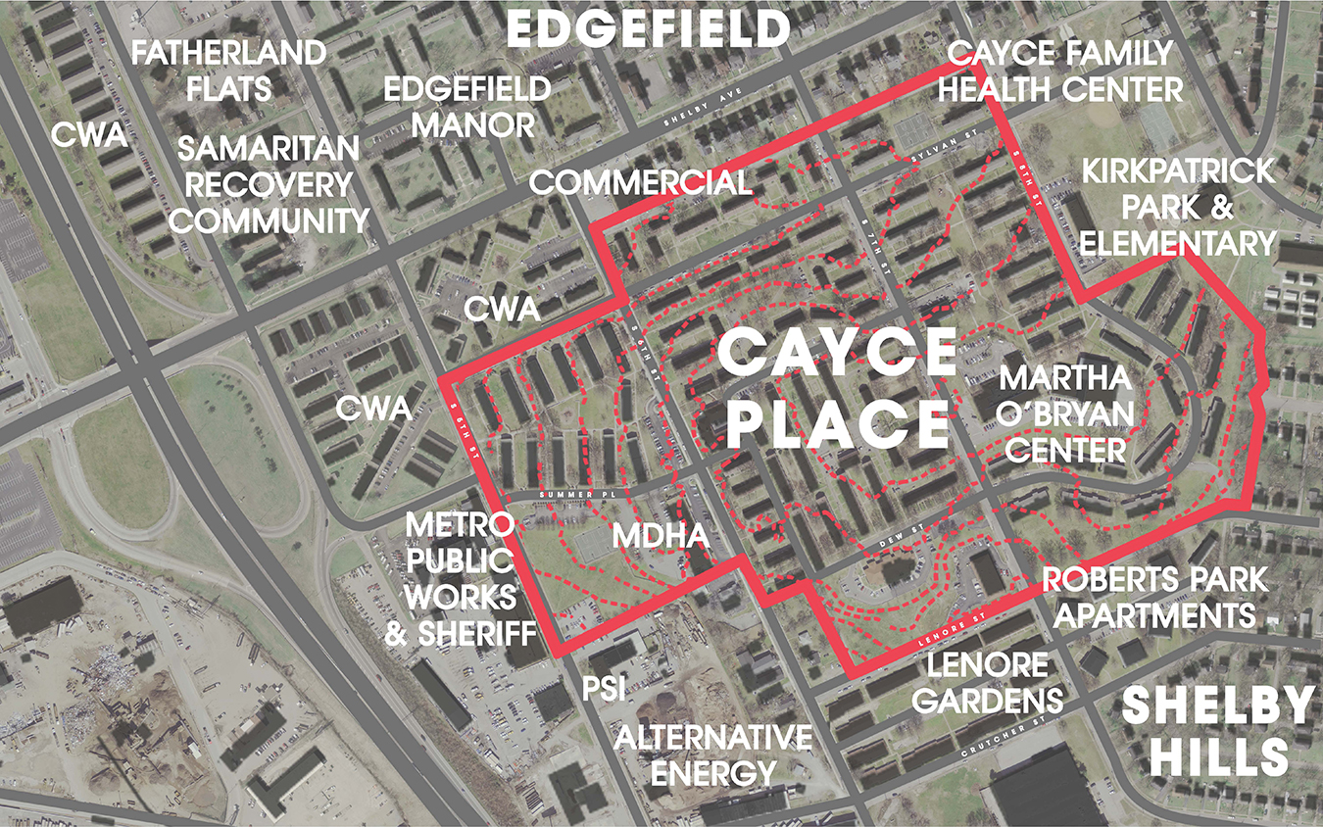
EJP - 3
REMINDER…our assignment
Notes:
CP – 64 acres
Nearing the end of its productive life and needs to be repositioned, especially in light of the federal funding challenges

Slide 4
REMINDER…this is also about families who live here today
…And who want to remain in the area in an affordable unit
Cayce Place – 716 households
Lenore Gardens – 75
Roberts Park – 74
CWA – 250

Slide 5
Highlights of Process so Far
Meetings with Cayce Place Residents
Meeting with Lenore Residents
Community Advisory Group Meetings
Interviews with key stakeholders
Door to Door Resident Survey
Preliminary Market Assessment
Existing Conditions Assessment

Slide 6
Needs assessment findings

Slide 7
Data Sources
Resident Survey
Surveys conducted by Cayce Place residents and East Nashville community members
77% Response Rate
Inquired about employment; safety, neighborhood resources; transportation; health; housing preferences; and community involvement
Promise Neighborhoods Survey Data
Administrative Data

Slide 8
Key Findings – Household Characteristics
High Occupancy - 99% (1/2013)
Long-term residents - Average tenure is 18.3 years
Average household size = 2.8
93% of households are female-headed; 76% of households have children; 5% of households with children are grand families

Slide 9
Key Findings – Education and Employment
Employment
Families are very low-income with median household income of $5,842 (all sources of income)
Only 36% of families report household income from work
Of those employed, 61% work 30 or fewer hours per week
Barriers to work: child care (19%), transportation (17%), disability (15%)

Slide 10
Key Findings – Mobility and Transportation
Average number of cars per households: 0.39
62% of households do not have a car
Transportation Barrier

Slide 11
Key Findings – Neighborhood Resources
27% rarely/almost never can get what they need in the neighborhood
42% said neighborhood rarely/almost never helps them fulfill their needs
80% would be very/somewhat likely to use a computer center if built

Slide 12
Key Findings – Supportive Services
78% have used at least one type of service in past year; respondents generally satisfied with services
Most common services residents need right now are:
Job training (59%)
Computer training (47%)
College prep (45%)
Youth programs (44%)
Credit repair (43%)
GED prep and testing (42%)
23% of households include someone with either a physical (15%) or mental disability (12%)

Slide 13
Key Findings – Children and Youth
33% of children ages 0-5 are not enrolled in an early learning program
School-aged children attend more than 20 different schools
Most commonly attended schools: Kirkpatrick Elementary (37%), Stratford High School (23%), Warner Elementary School (19%), and Bailey Middle School (17%)
These schools perform below the district average on achievement tests; however, 78% of parents believe the quality of their children’s education is excellent or good
Almost half (47%) of parents disagree/strongly disagree that they are comfortable taking their children to parks and playgrounds in the neighborhood

Slide 14
Key Findings – Health
2/3 reported being in excellent or good health
80% report having a medical home; 15% use the UNHS Cayce Family Clinic
However, 17% use the emergency room when sick or in need of health advice; 47% described the medical services in the neighborhood as average or very poor
The most common unmet health care needs are: dental services (48%), vision care services (39%), and domestic violence services (26%)

Slide 15
Key Findings – Public Safety
39% feel somewhat/very unsafe in their neighborhood during the day, 61% at night
Most common types of crimes respondents have experienced: hearing gun shots (79%), teenage fighting (57%), and sale of drugs (46%)
The most needed public safety strategies are: better security systems (86%), better street lighting (81%), anti-gang initiatives (80%), youth violence/crime prevention programs (79%), and more visible police controls (75%)

Slide 16
DESIGN CHARrETTE + RESIDENT MEETINGs

Slide 17
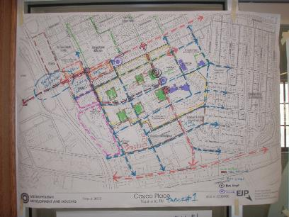
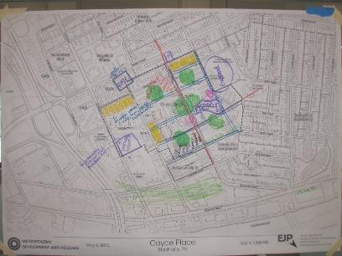
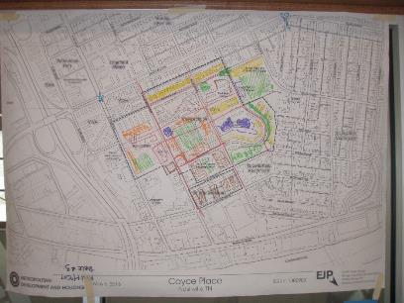
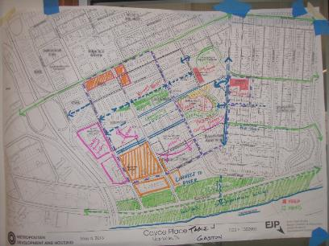
Community Recommendations from Charrette
Notes:
Also available at CP website

Slide 18
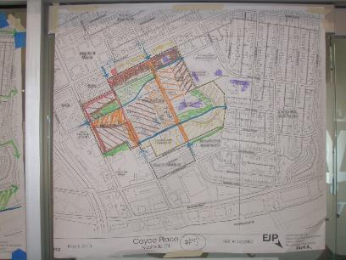
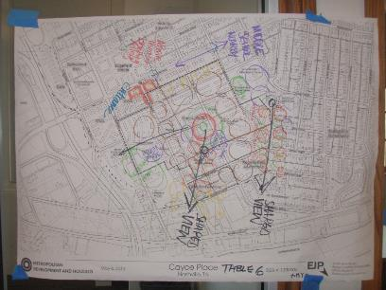
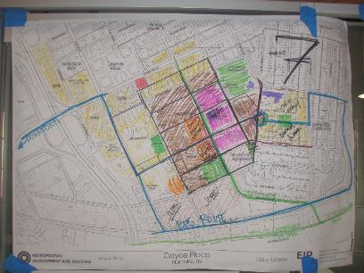
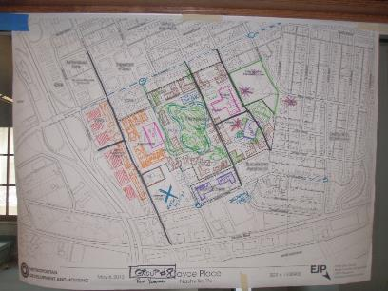
Charrette…cont’d

Slide 19
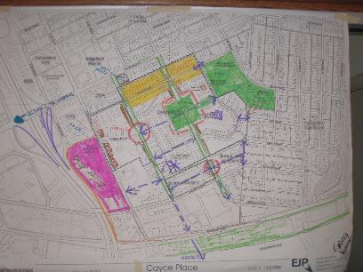
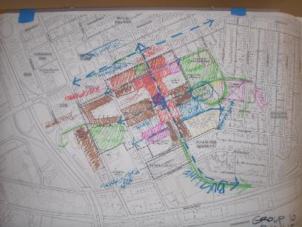
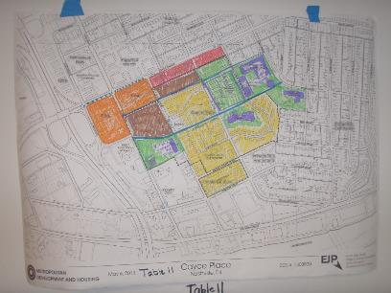
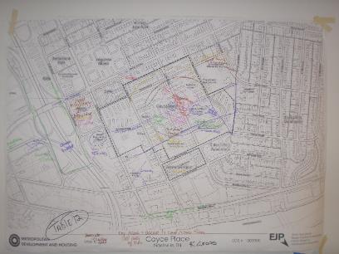
Charrette…cont’d

Slide 20
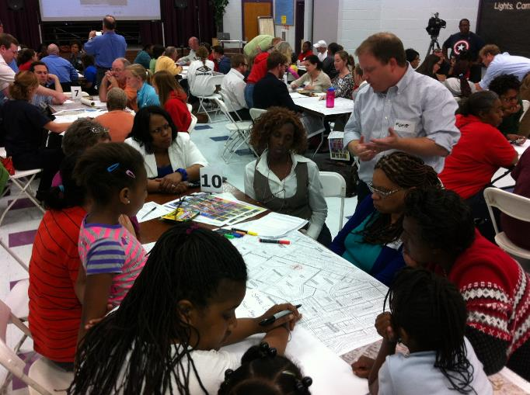
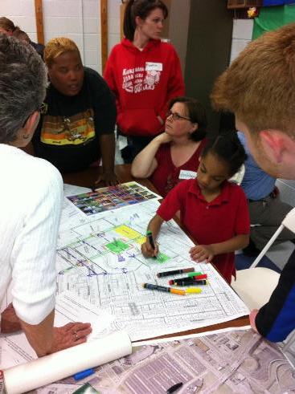
Major Themes
Preserve public and affordable housing units; minimize disruption to residents
Retain/improve key community assets
Retain, but improve park and open space
Expand retail options
Maximize neighborhood potential – views and proximity to downtown, highway, gateway to East Nashville
Notes:
New/Improve
Minimize Disruption to Residents
Expand retail (neighborhood retail and grocery)
Improve access to healthy food (Grocery Store / Community Garden / Farmers Market)
Improve/Increase park/open space access and locations
Improve connections to neighborhoods, river, Davidson bike route,
Improve program/recreational elements in open space (play fields, playgrounds, sports fields, small amphitheater, splash park, etc.)
Safety - Better lighting, sidewalks / bike lanes, cross walks, porches/stoops
Offer diverse housing options (types, affordability, density)
Provide for new/improved educational facilities & daycare
Improved access to Transit (Expanded routes/new stops)
Capitalize on views
Lower Density near Shelby Hills/Higher Density near Interstate
Healthy, efficient, larger Public Housing Units

Slide 21
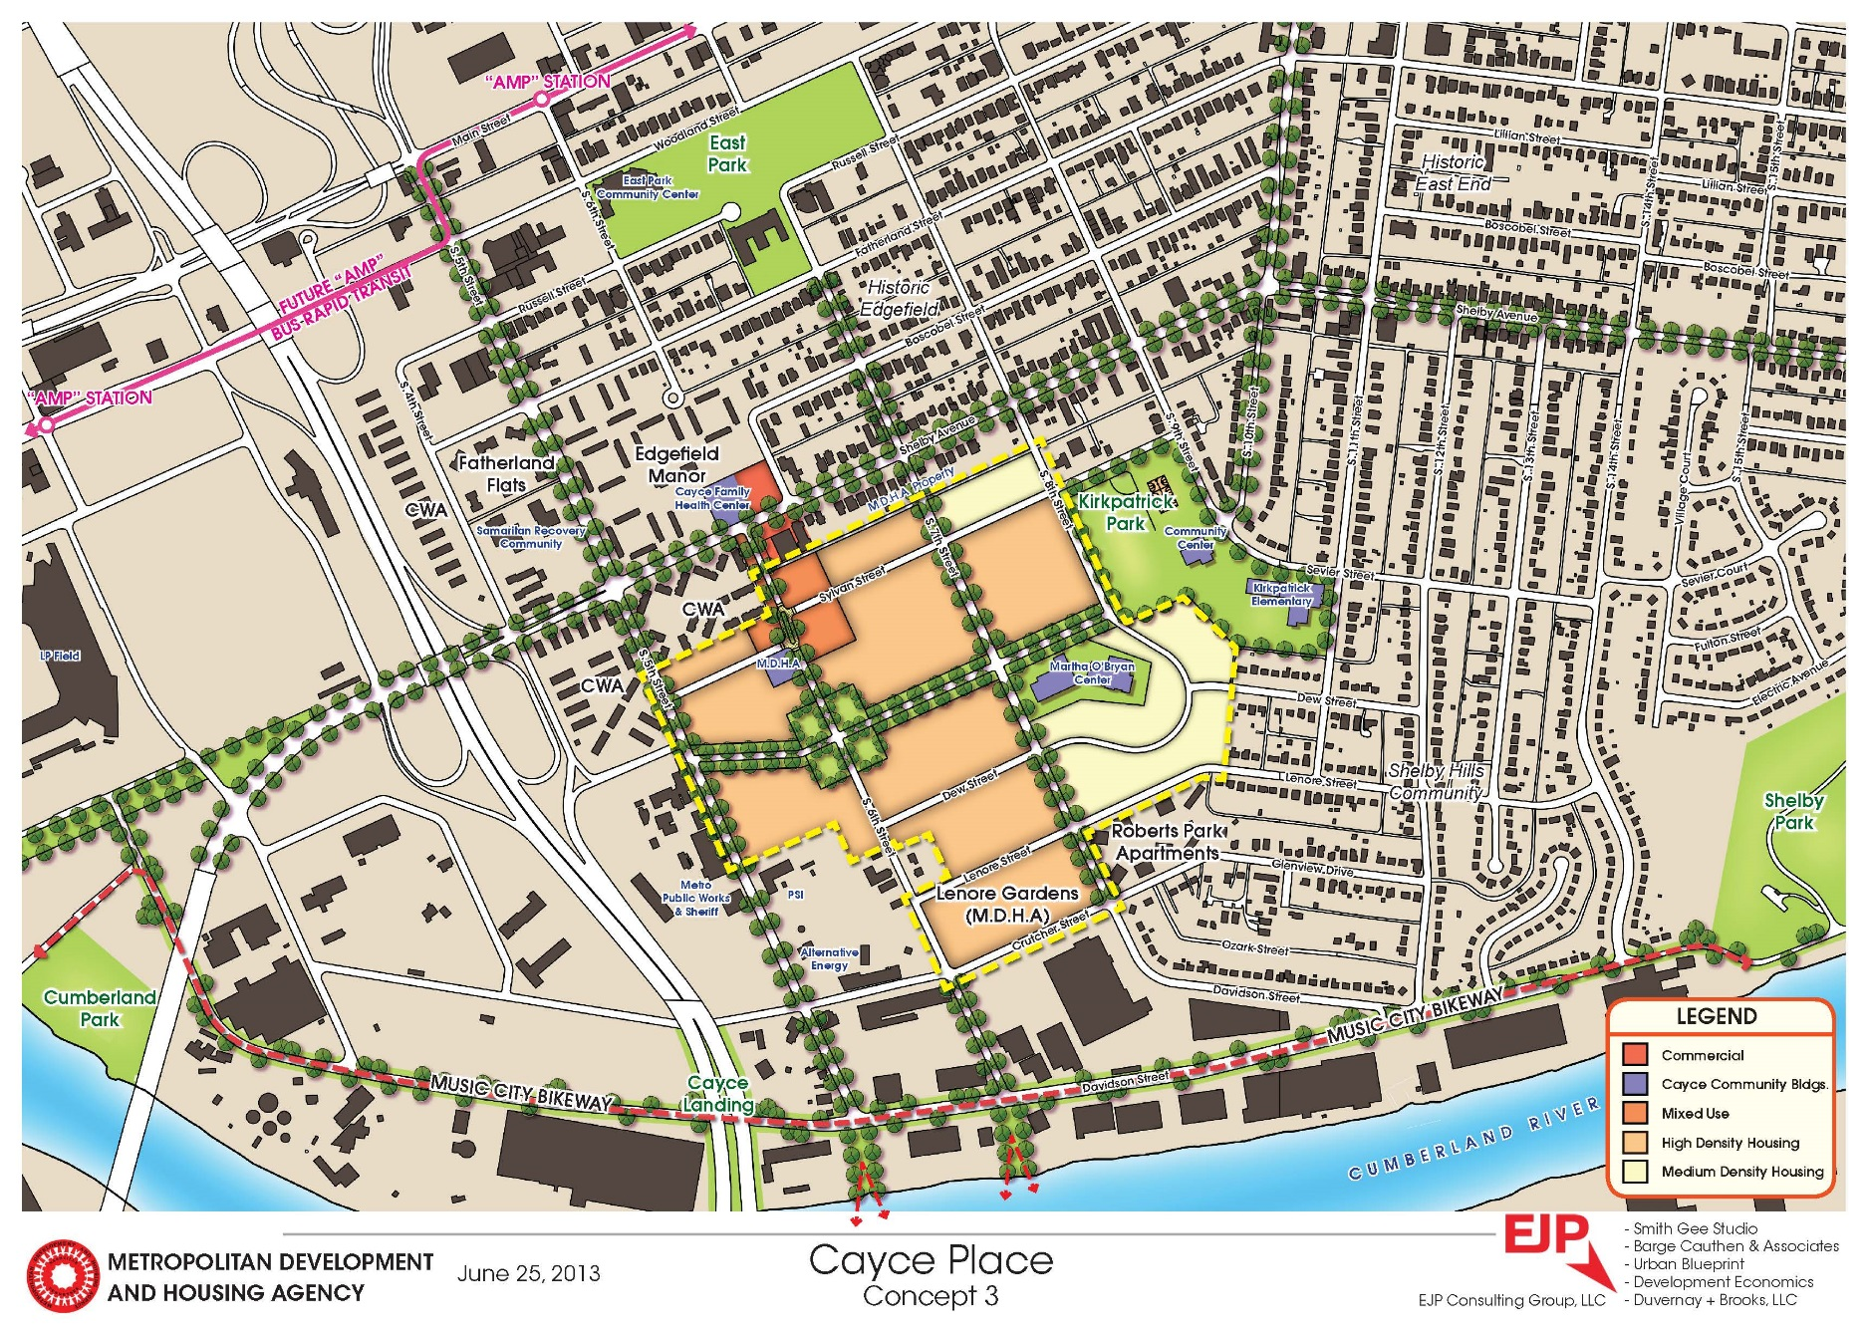
Plan Concept #1 – MDHA-Owned Land

Slide 22
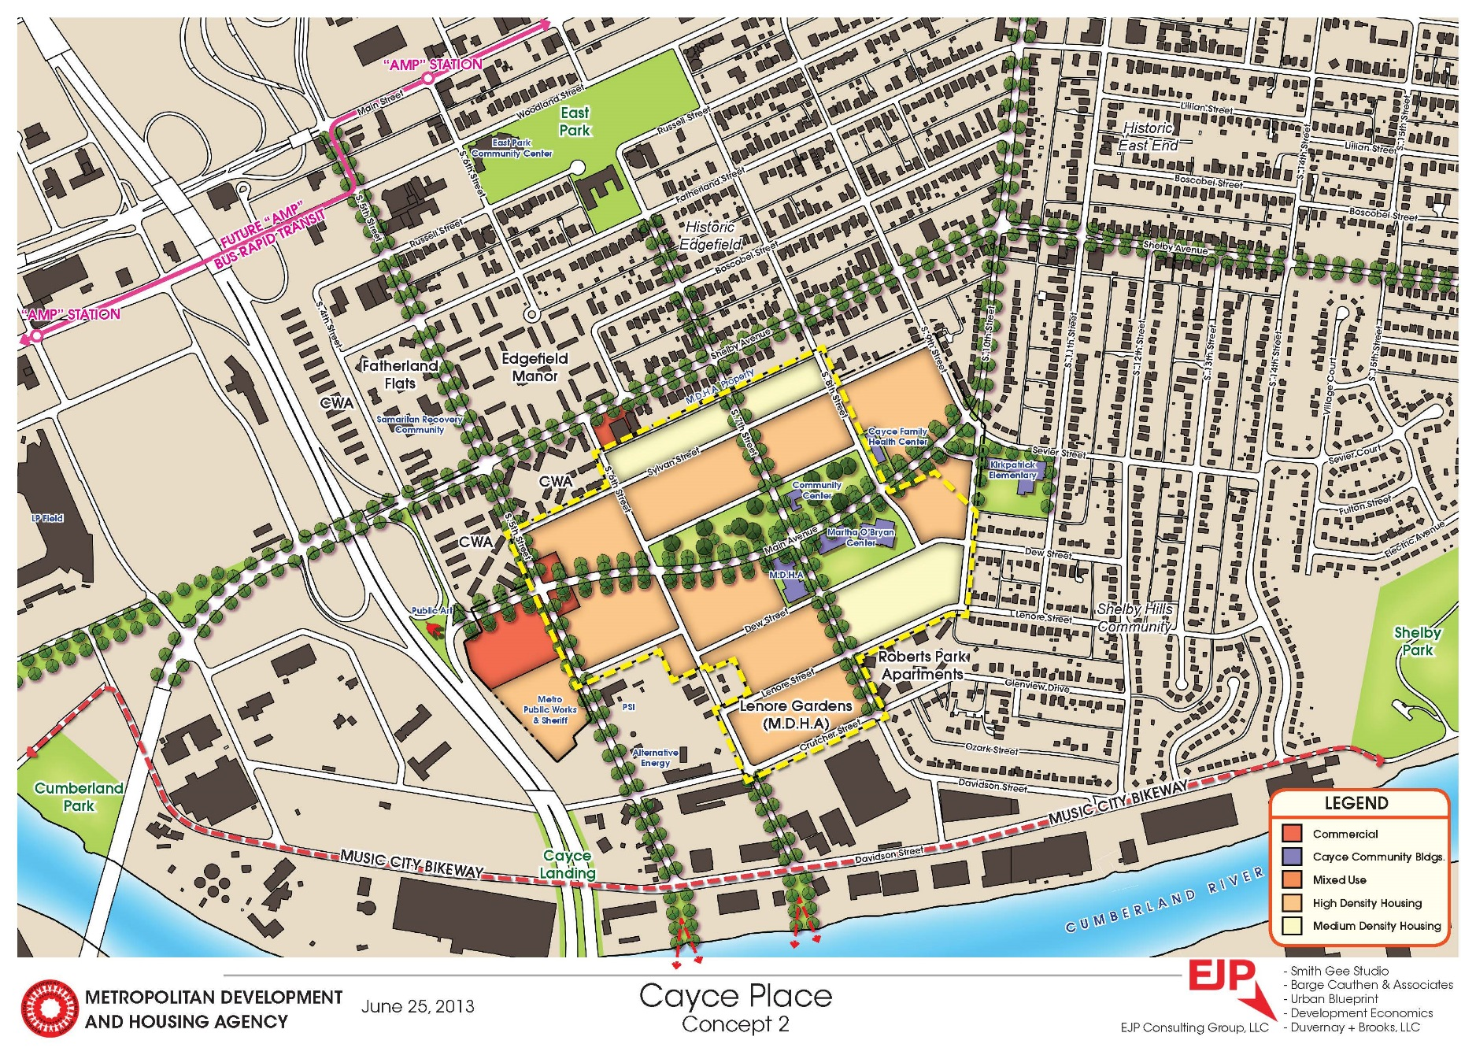
Plan Concept #2 – MDHA/Metro-owned Land

Slide 23
Plan Concept # 3 – MDHA + Other Owners

Slide 24
Preliminary redevelopment plan and program
MDHA-Controlled Sites

Slide 25
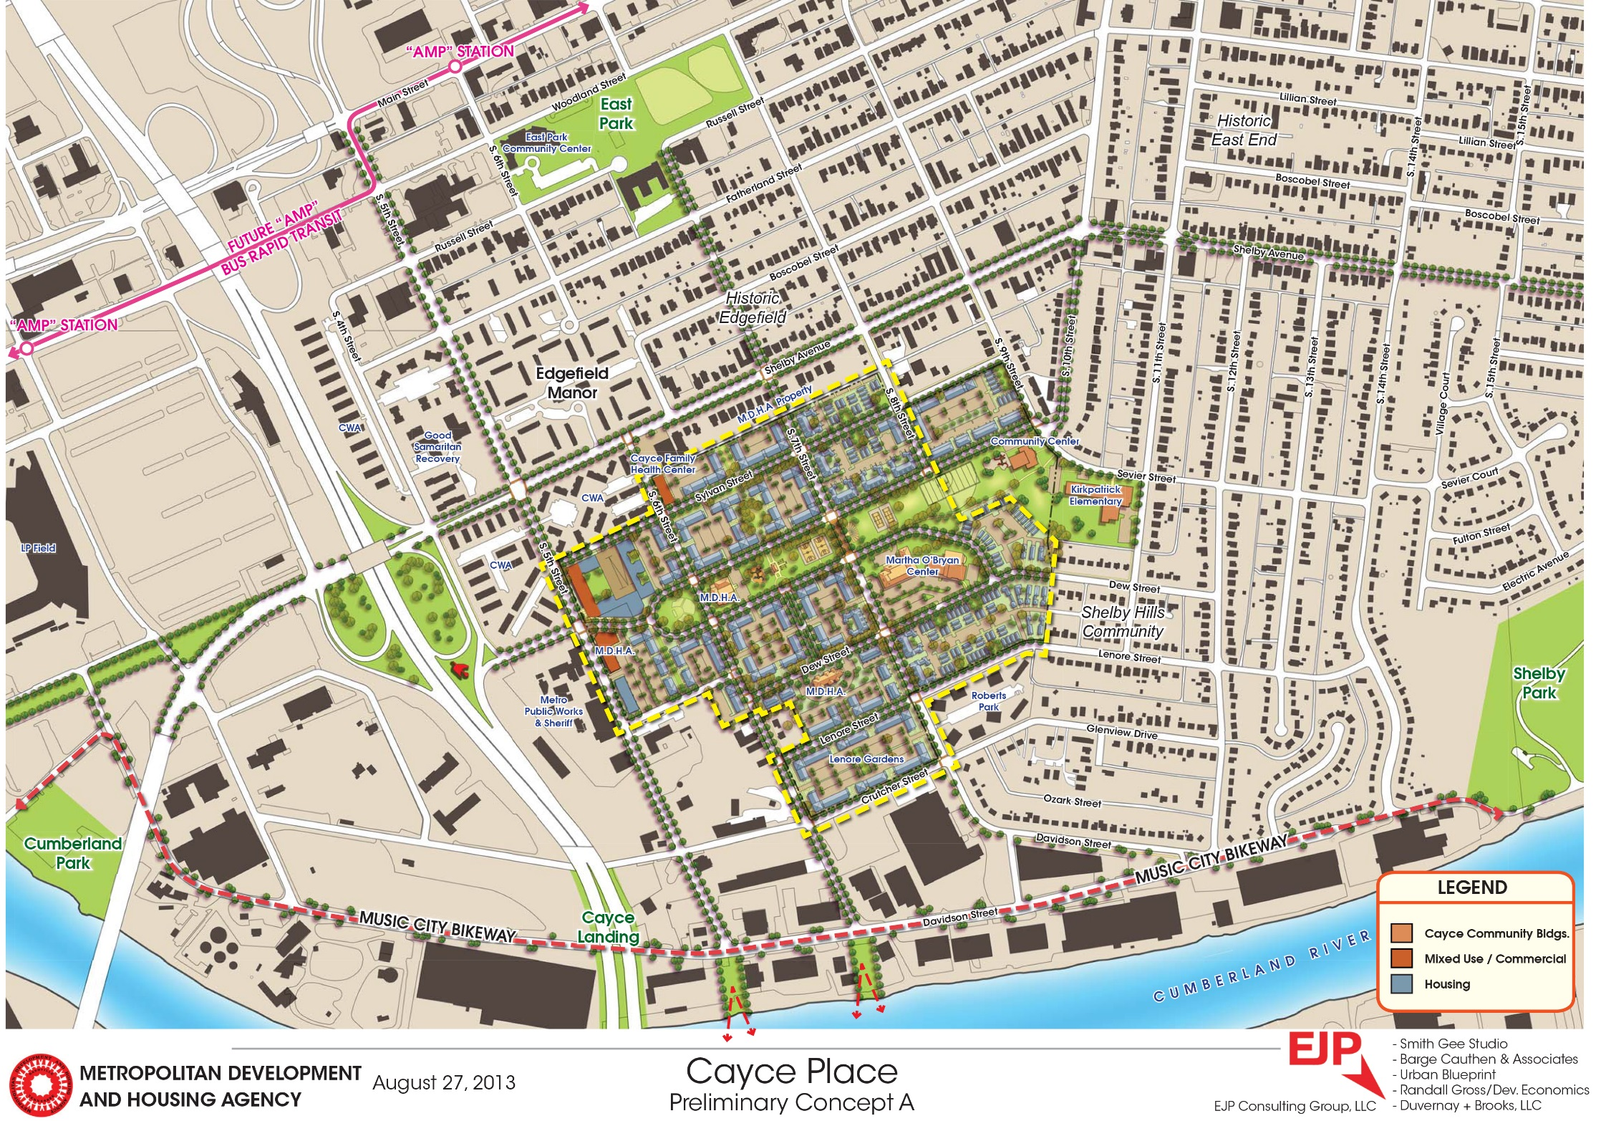
Preliminary Plan

Slide 26
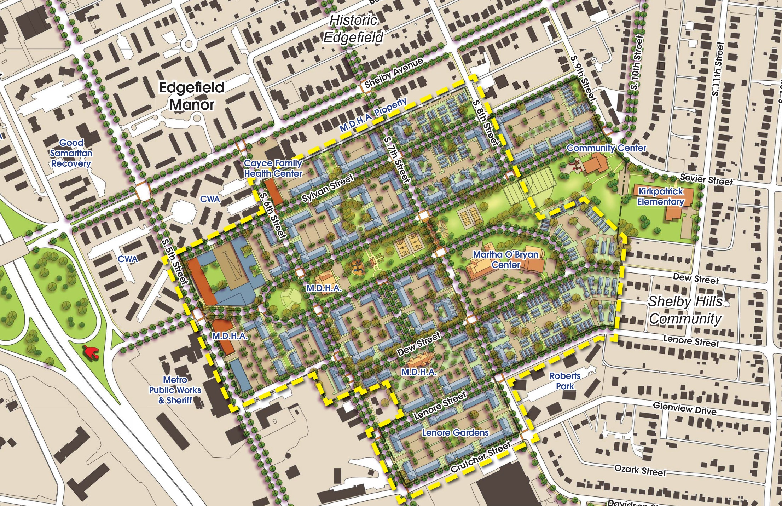
Preliminary Plan

Slide 27
Preliminary Plan

Slide 28
Preliminary Plan

Slide 29
Preliminary Plan

Slide 30
Preliminary Plan – Existing Trees

Slide 31
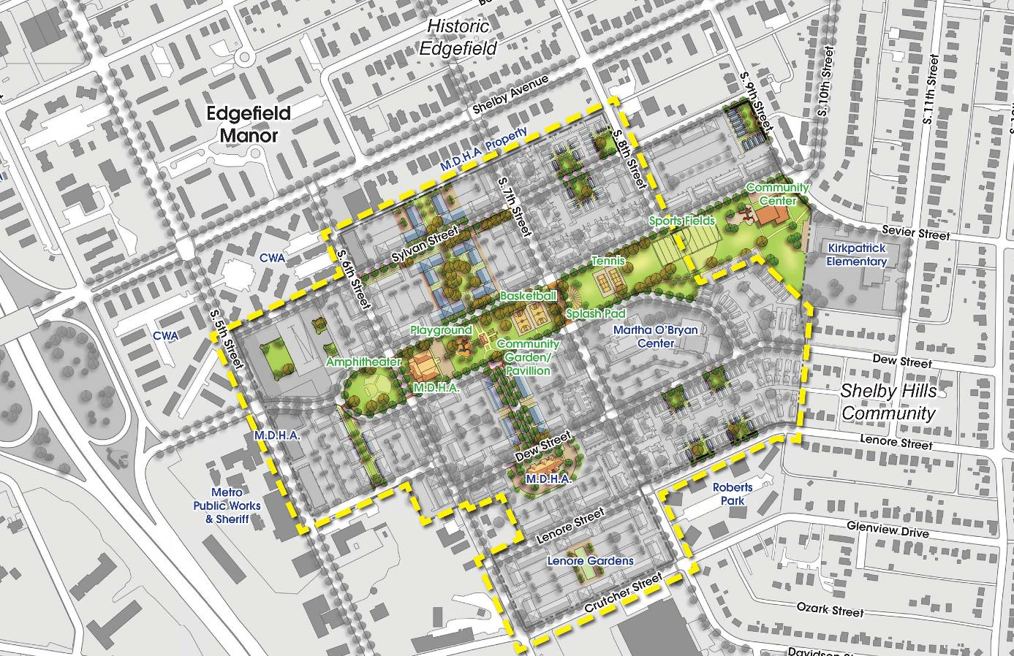
Open Spaces

Slide 32
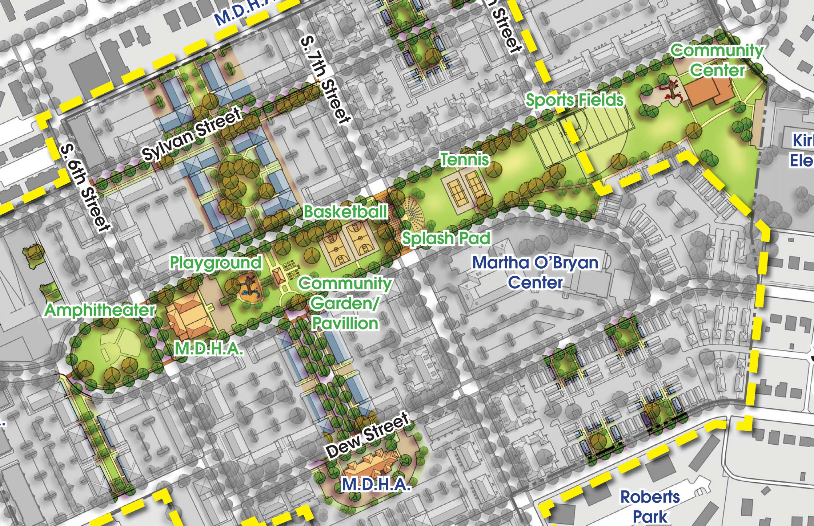
Open Spaces

Slide 33
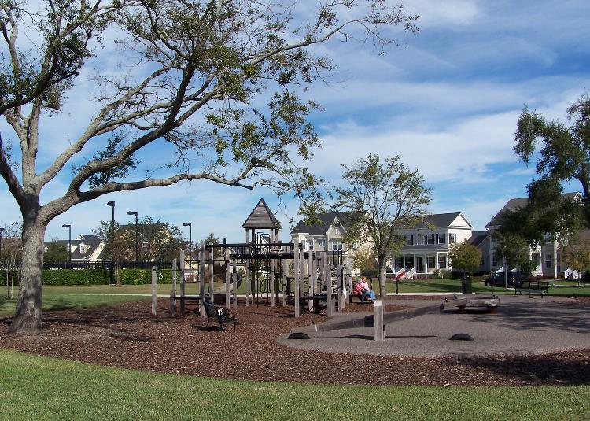
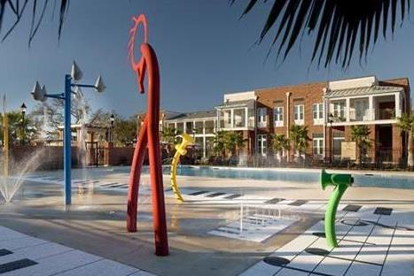
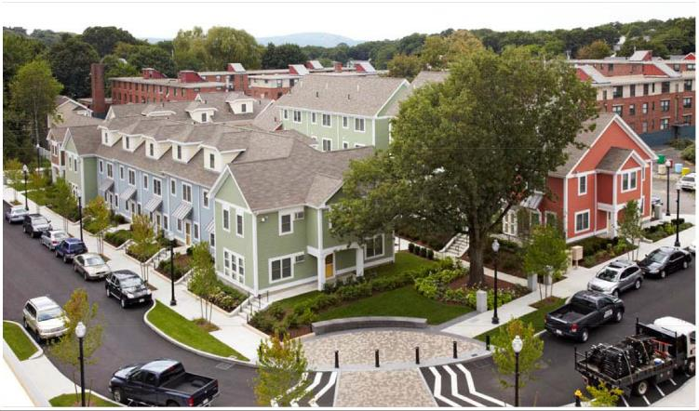
Open Spaces

Slide 34
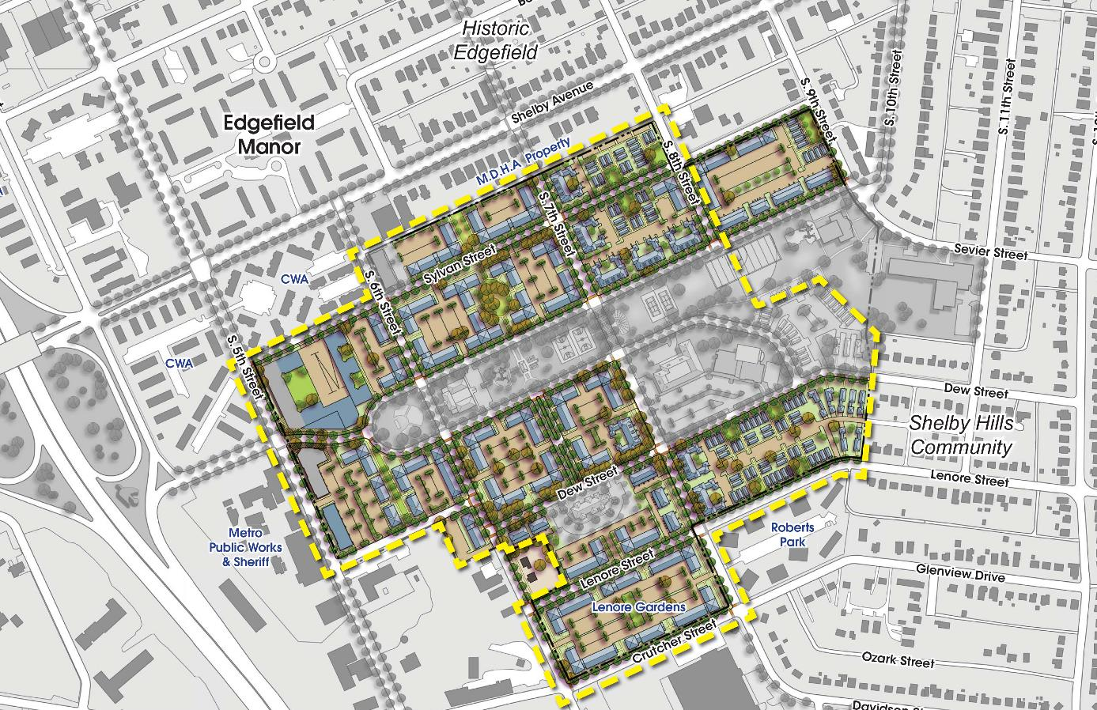
Residential Character

Slide 35
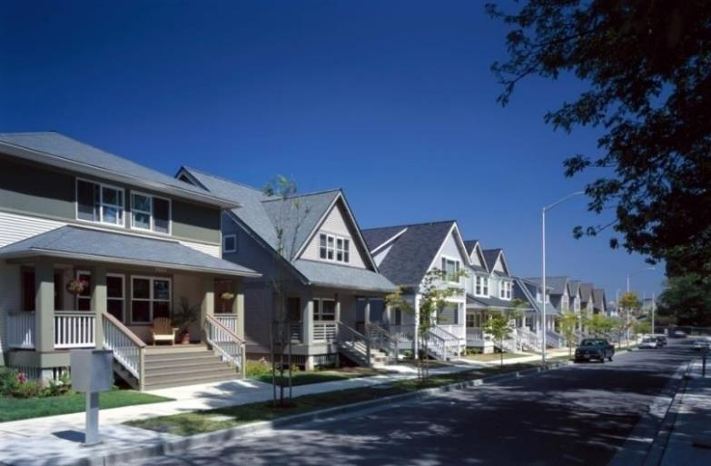
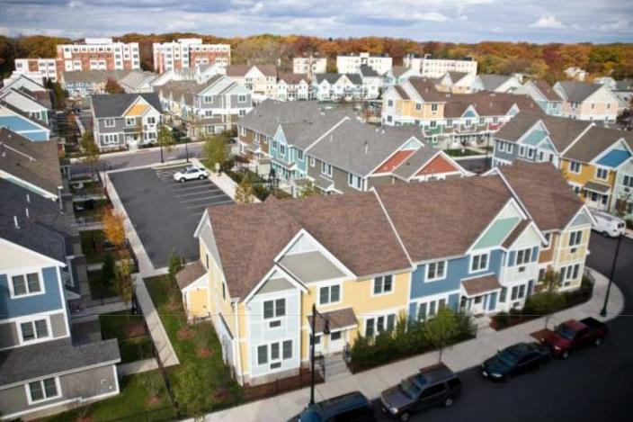
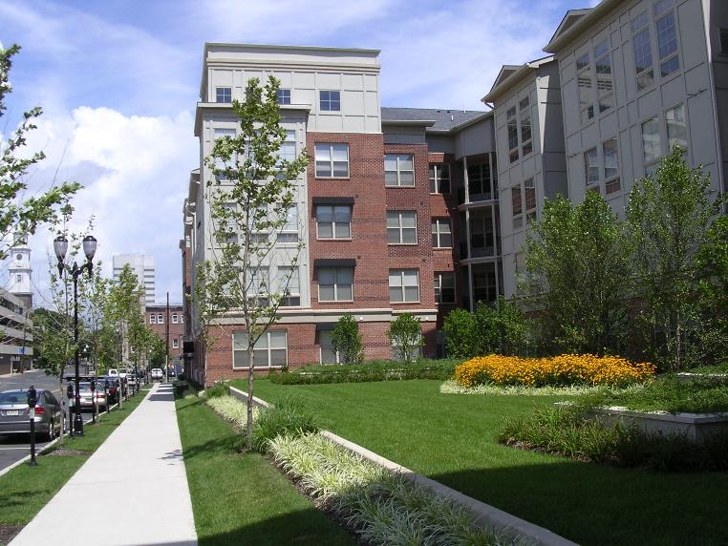
Residential Character

Slide 36
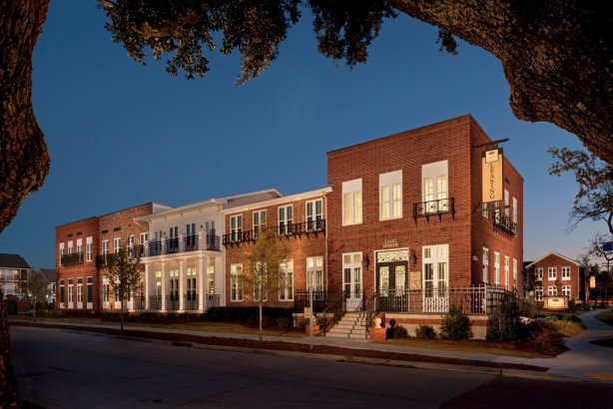
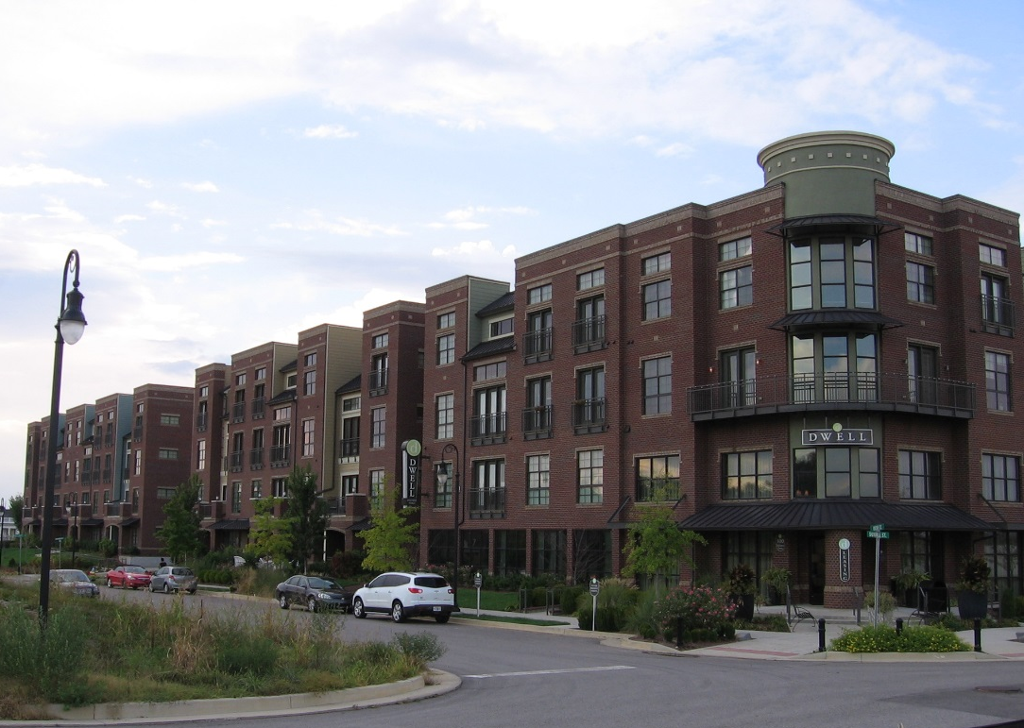
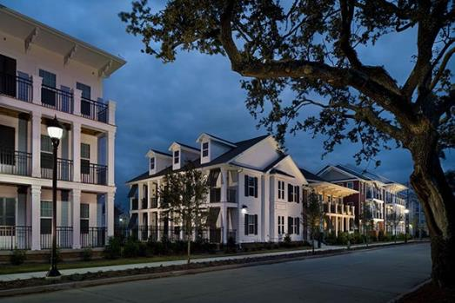
Residential Character

Slide 37
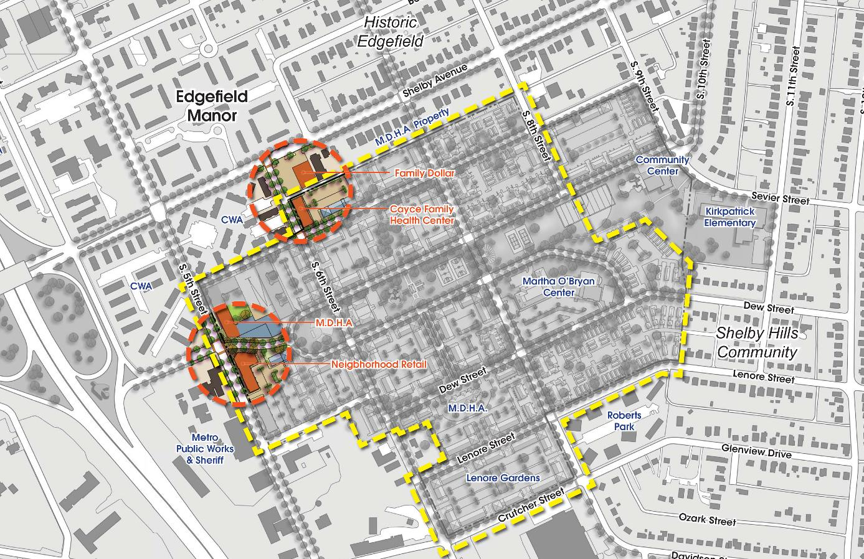
Neighborhood Center

Slide 38
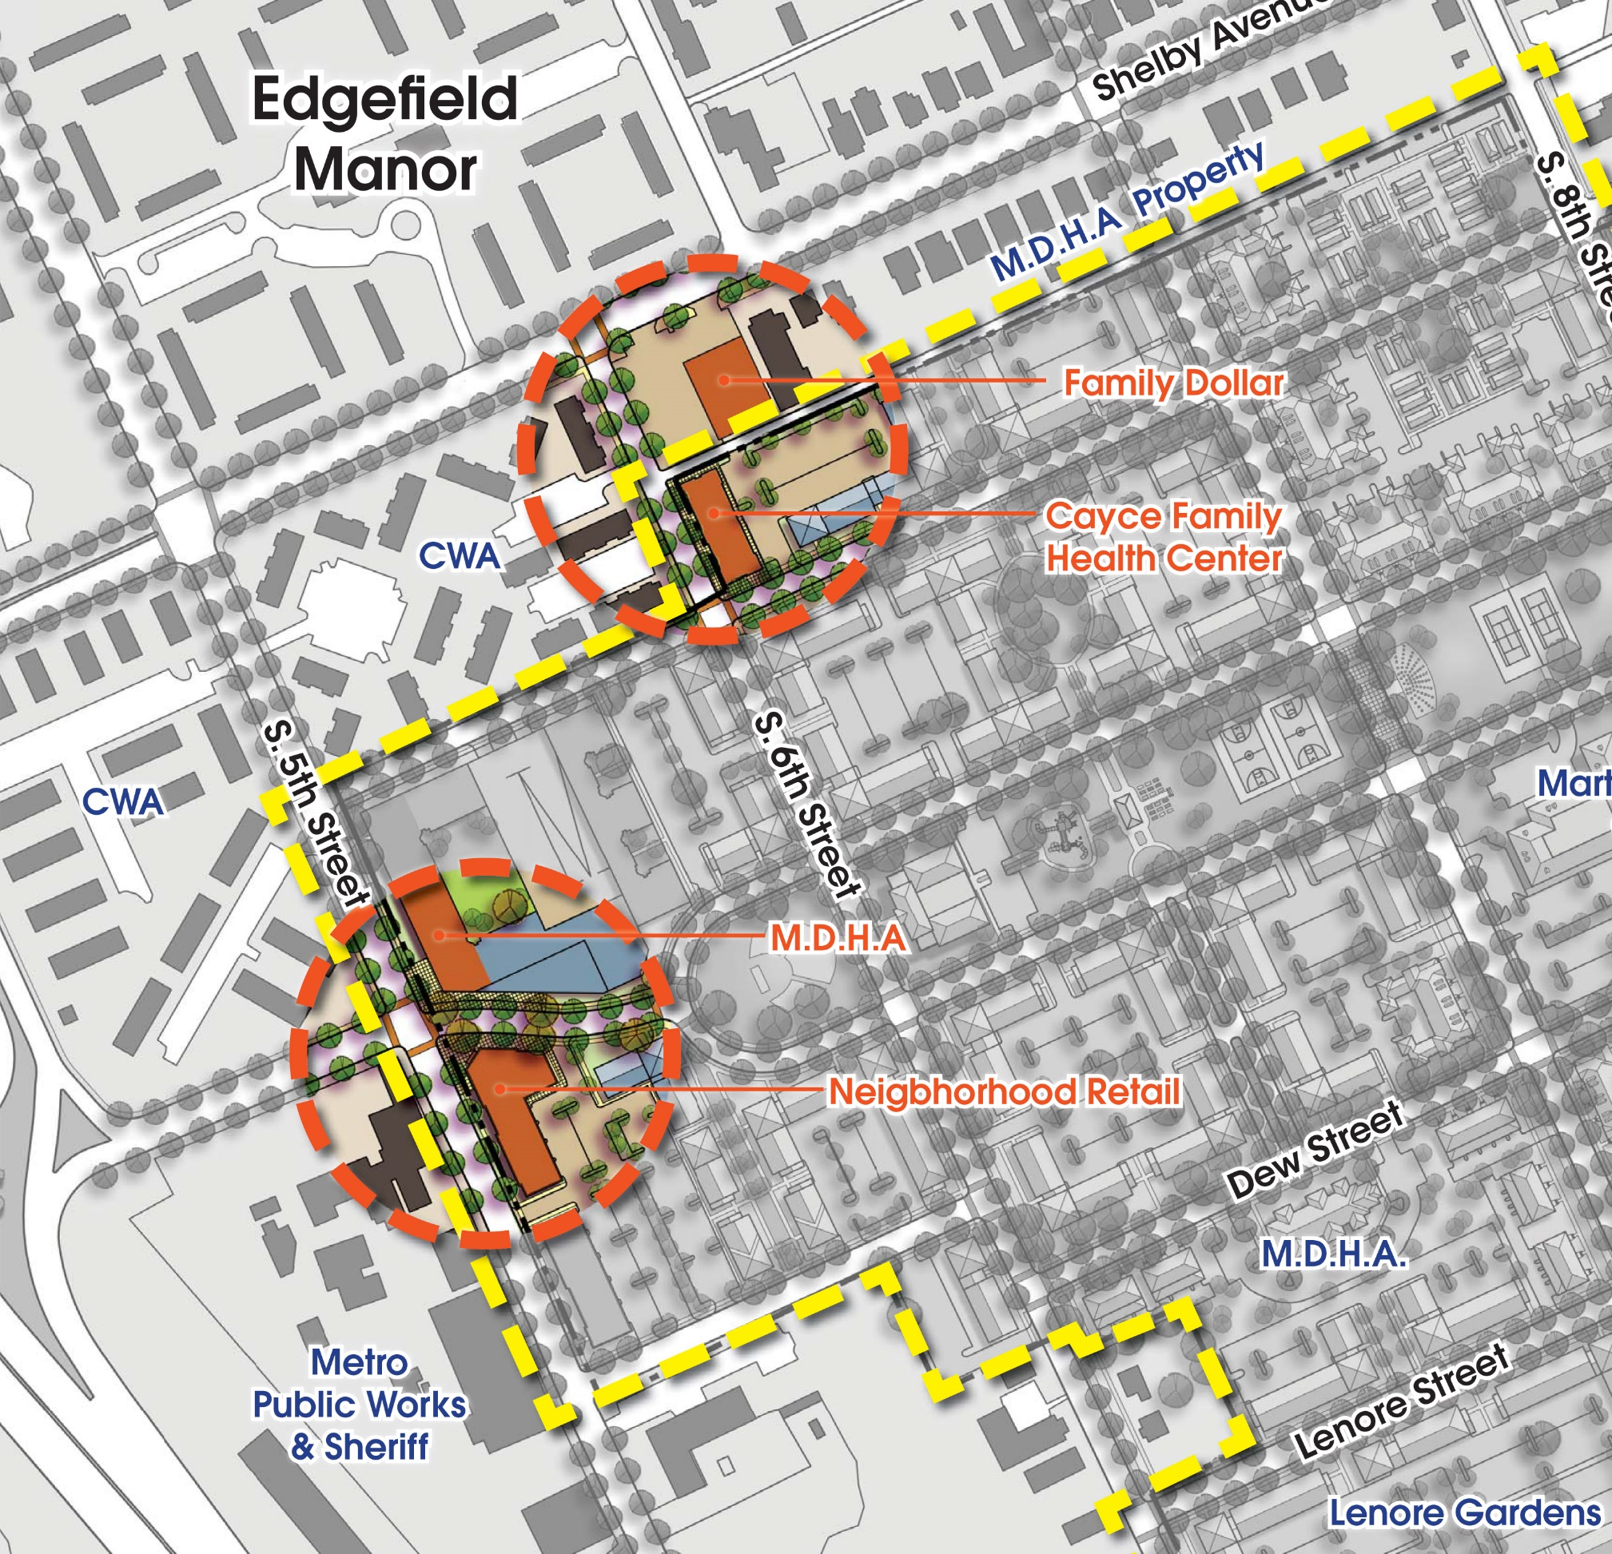
Neighborhood Center

Slide 39
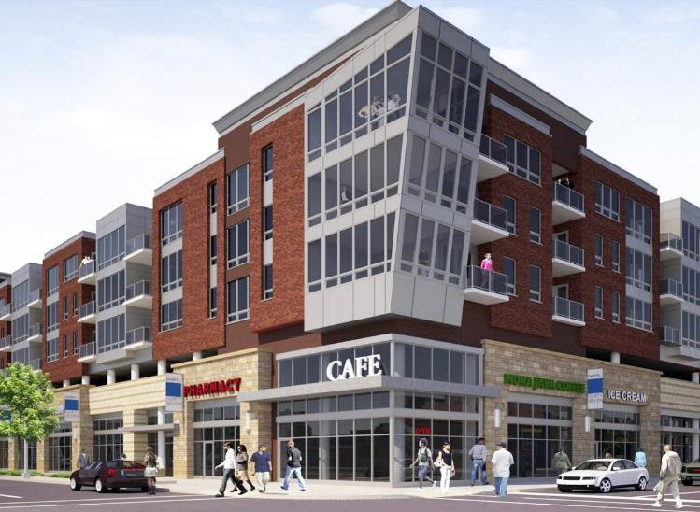
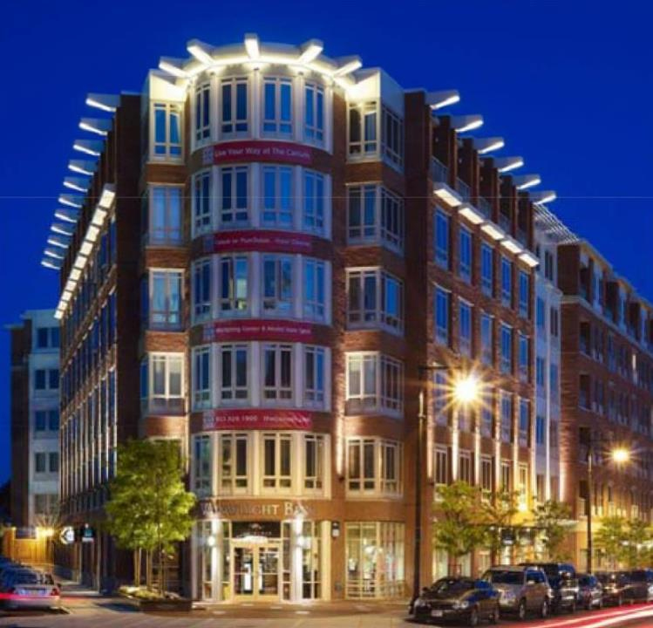
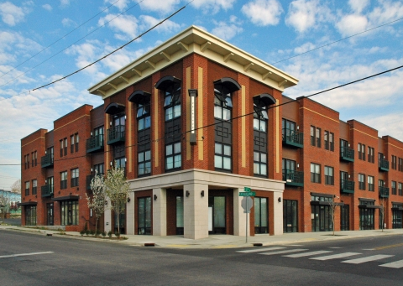
Neighborhood Center
Provided by SitePhocus

Slide 40
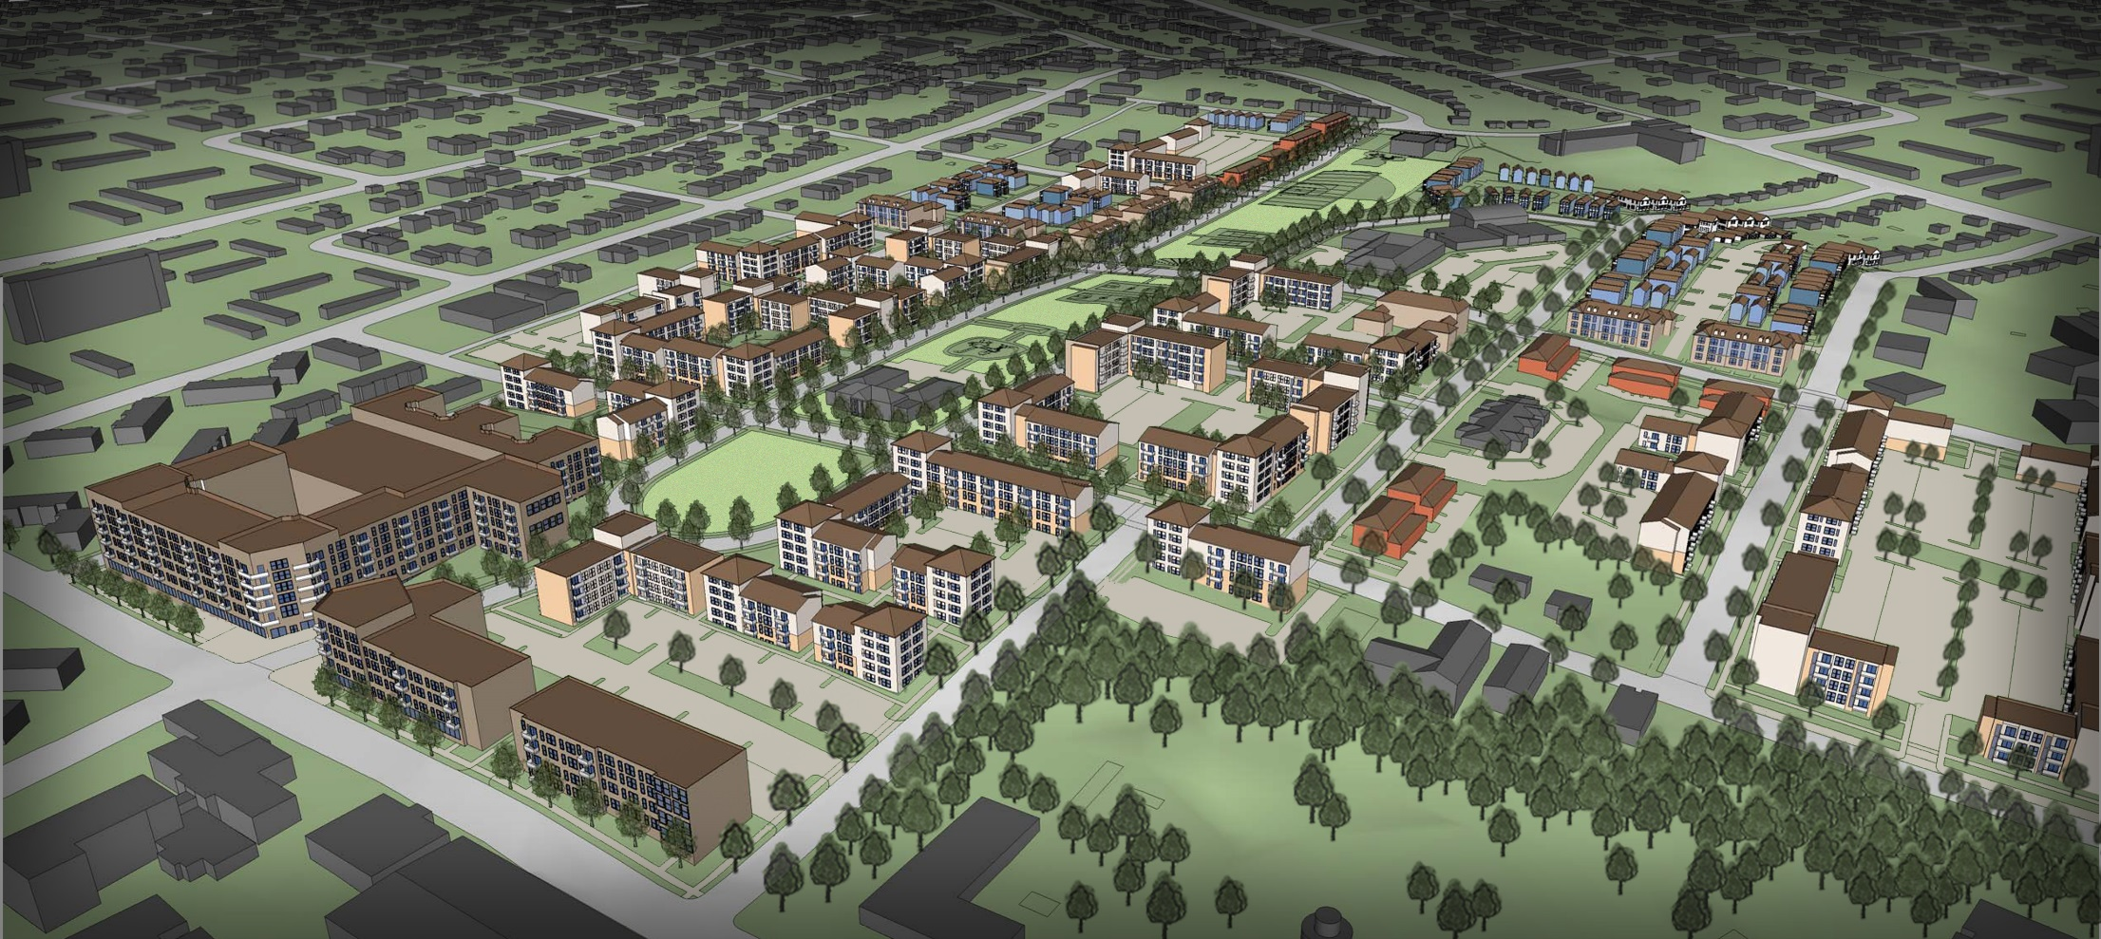
Aerial View

Slide 41
Preliminary Plan – School Option

Slide 42
Preliminary Program – MDHA Only
HOUSING TYPE | INCOME RANGE | # of Units
CP Replacement Units | 0-30% AMI | 716
Tax Credit Units | 51-60% AMI | 424 +/-
Market Rate | Above 60% AMI | 344 +/-
1,484 units - 48% Cayce Place replacement units; 52%Unassisted/Market Rate Phased Demolition of CP and Lenore
Non Residential Uses | Square Feet
Retail | 27,500 +/-
Institutional/Office | 35,000 +/-
Total | 62,500 +/-
Complete Infrastructure Upgrade Relocated and Improved Park/Open Space

Slide 43
Expanded vision
Sites Not in MDHA’s Control

Slide 44
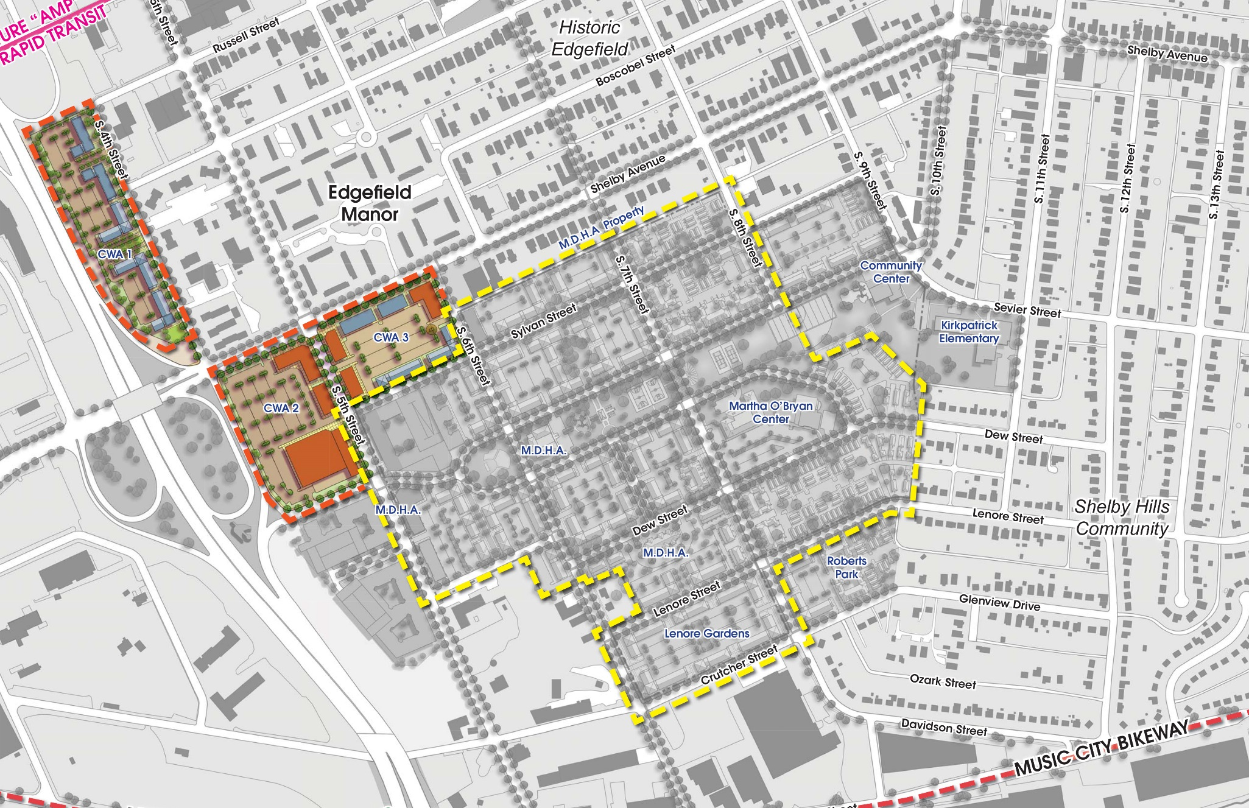
Preliminary Plan - CWA

Slide 45
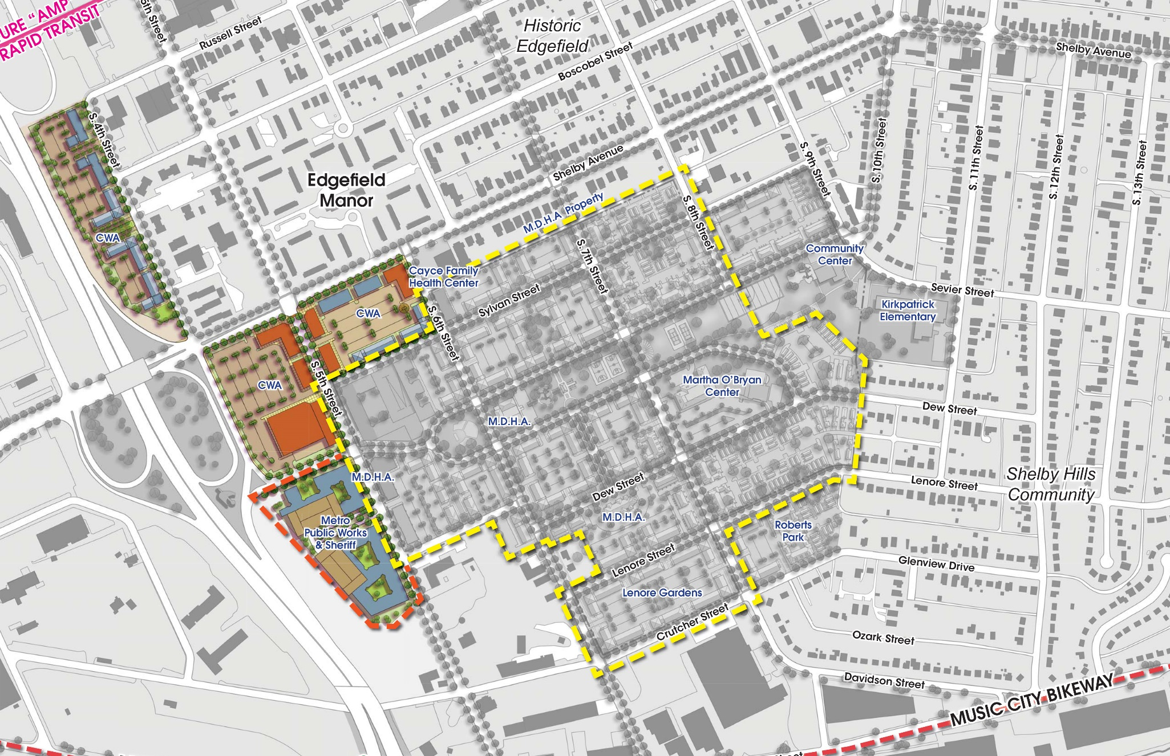
Preliminary Plan – Public Works/ Sheriff’s Site

Slide 46
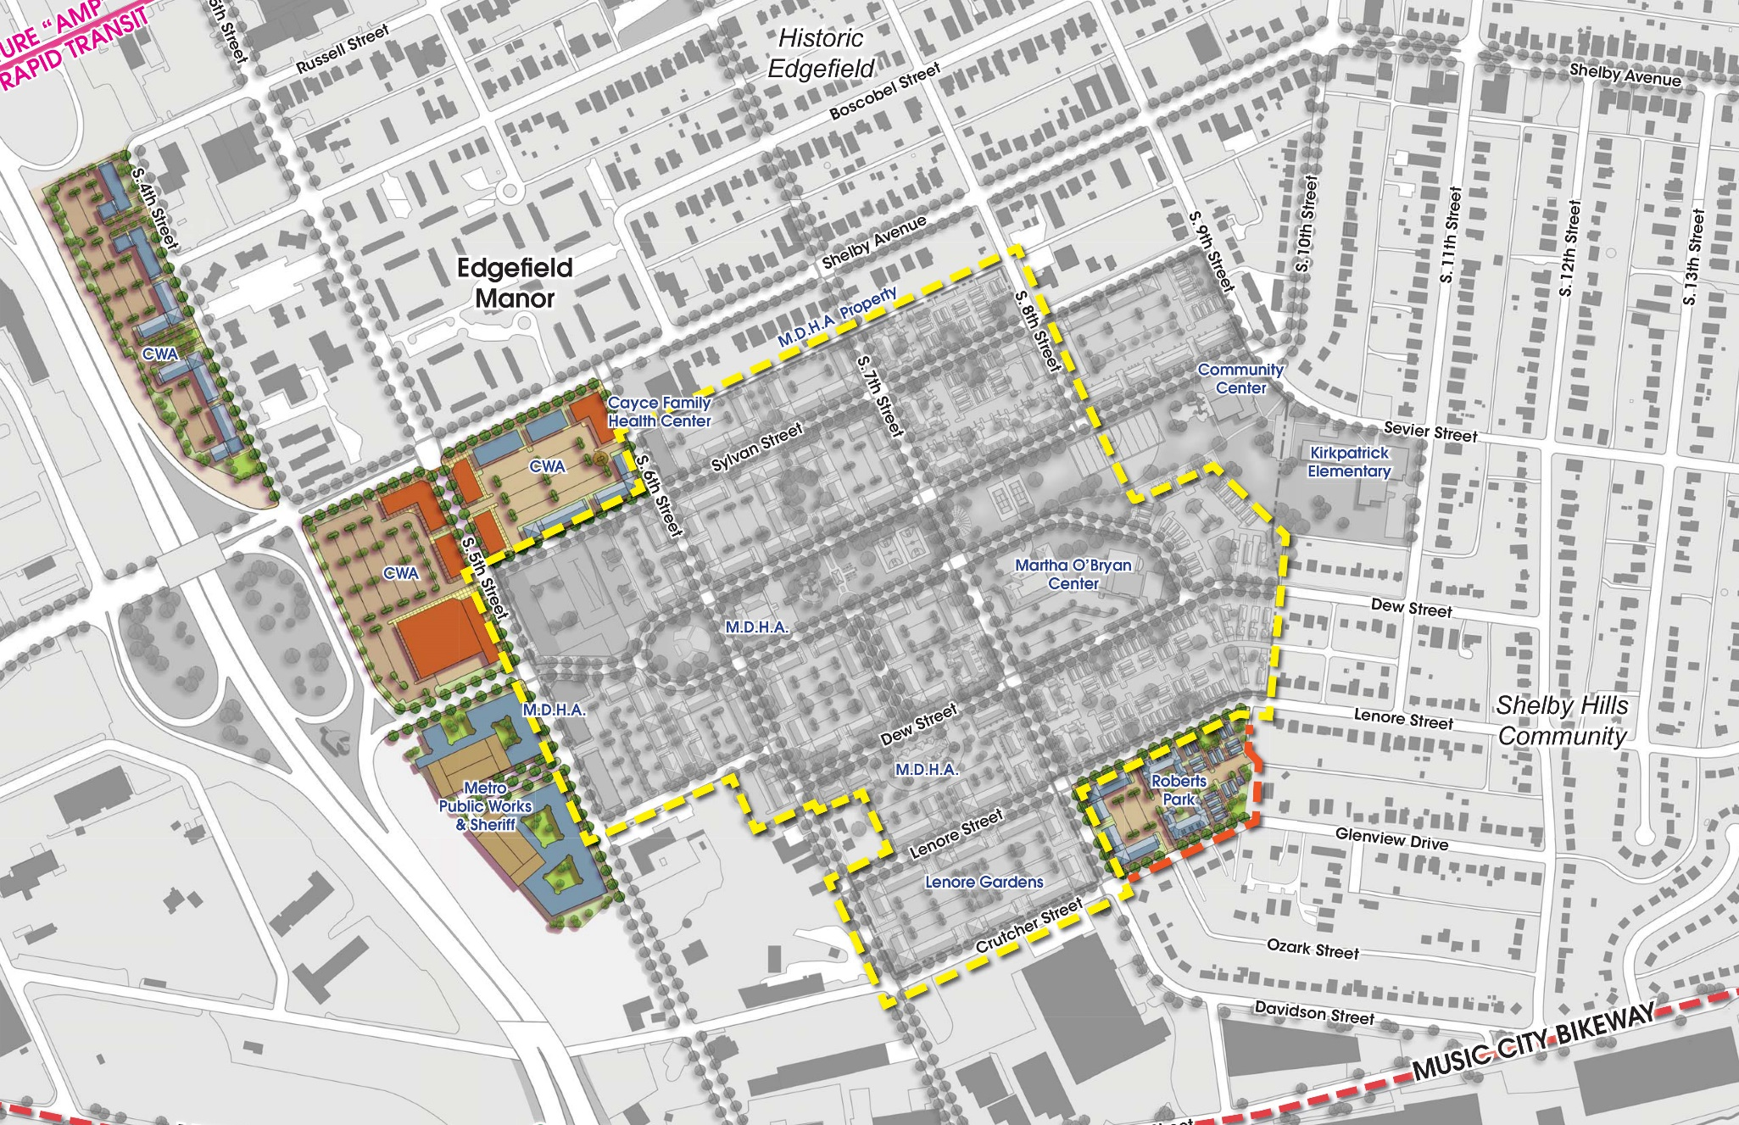
Preliminary Plan – Robert’s Park

Slide 47
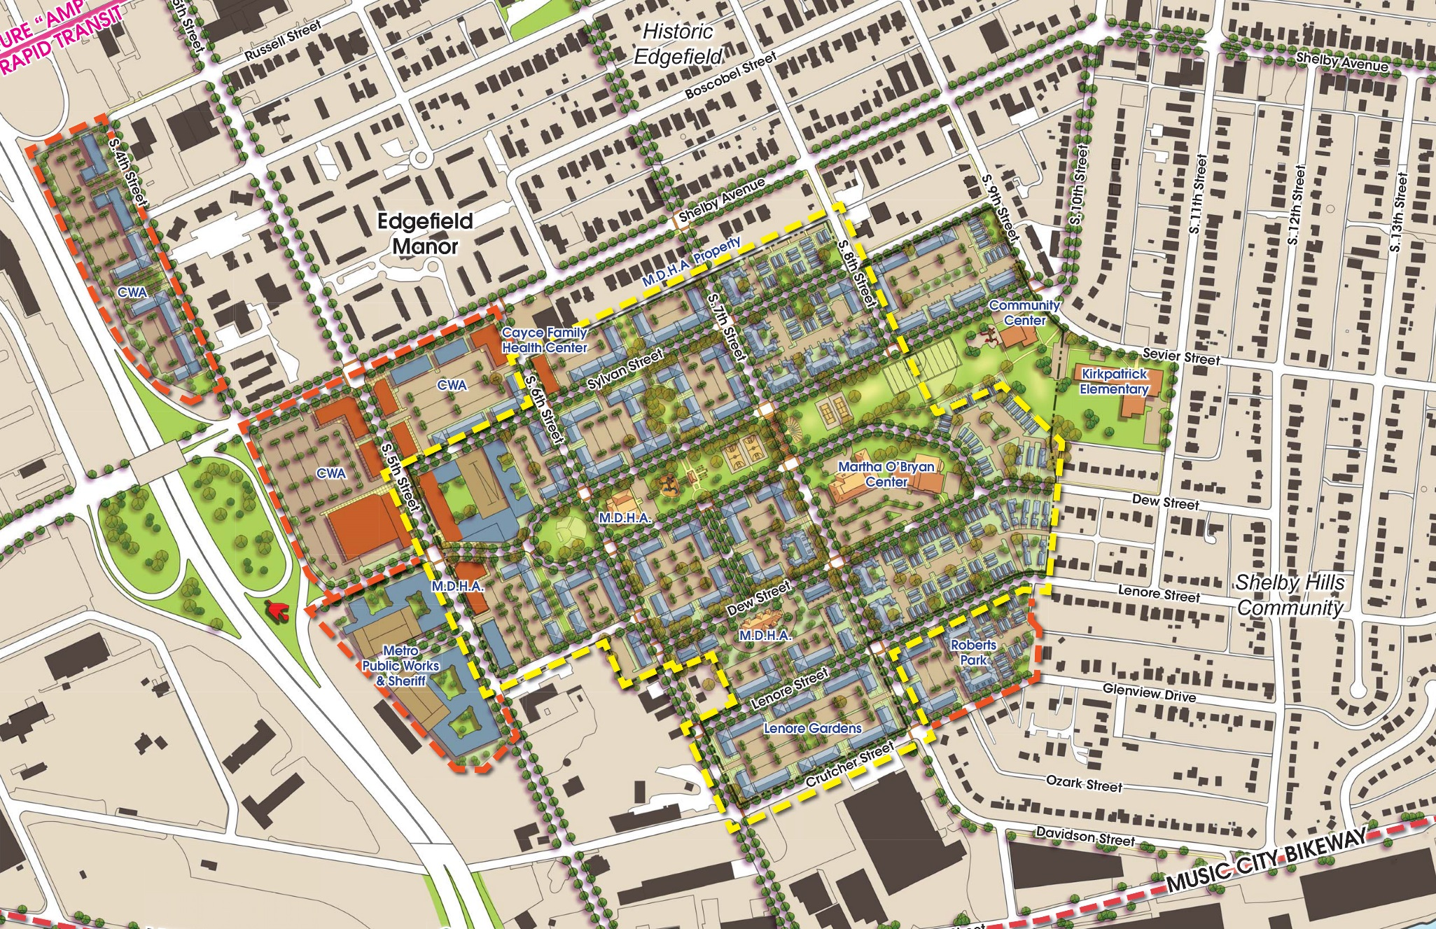
Preliminary Plan – All Additions

Slide 48
Preliminary Program – All Sites
HOUSING TYPE | INCOME RANGE | # of Units
CP Replacement Units | 0-30% AMI | 716
CWA Replacement Units | 0-30% AMI | 250
Tax Credit Market Rate | Less than 60% AMI Unrestricted | 1,505 +/-
2,471 Total Units 40% CP + CWA Replacement; 60% Unassisted/Market Rate Phased Demolition of CP and Lenore 1,350 Parking Spaces
Non Residential Uses | Square Feet
Retail | 117,000 - 200,000 +/-
Institutional/Office | 35,000 +/-
Complete Infrastructure Upgrade Relocated and Improved Park/Open Space Relocation of Sheriff and Public Works Offices Approximately 84.2 acres

Slide 49
Relocation & RESIDENT RIGHT OF RETURN

Slide 50
Relocation Eligibility
There will be 716 CP Replacements Units in the revitalization plan
Any household living at Cayce Place on the date HUD approves the revitalization plan is eligible to return and MDHA will provide relocation benefits and assistance
MDHA will pay for relocation costs if household is required to move temporarily or permanently
Notes:
Note “exceptional hardship” exception for undocumented immigrants and persons not on the lease

Slide 51
Relocation Benefits
Relocation benefits will be available to eligible Cayce Place residents, as required by the URA:
Comparable housing unit that meets the family’s need (# of bedrooms, accessibility, etc.)
Moving expenses – move off the site and to move back to the redeveloped site
Security and utility deposit, if required by private landlord at the time of relocation
Replacement Housing Payments (most will be zero)
MDHA will only pay for moves of family members who are formally on the lease
MDHA to provide relocation counseling and supports prior to, during and after relocation
Notes:
Definition of comparable housing unit: decent, safe and sanitary (meets HQS), equivalent or better than the household’s current unit; similar proximity to residents’ place of employment, school, and services; affordable to resident; appropriately sized to the number and age of household members
Moving Expenses typically include: moving, packing and unpacking, utility disconnect and reconnect, inspection fee (voucher), credit check (voucher)
Moving Expenses may be paid as reimbursement for actual moving expenses, paid as a fixed allowance based on federal guidelines, MDHA organizes and pays for move itself.
Deposits: paid directly from MDHA to landlord/utility company, deposit must be returned to MDHA when resident moves out, MDHA will return deposit to resident (minus damages) if relocates with a voucher.
RHP: if a household pays more in monthly rent and utilities in new unit, THA will pay the difference for up to 60 months. Payment made directly to landlord. This is usually $0.
HO Assistance: MDHA will provide $5,250 in downpayment assistance for residents who are ready and able to purcahse an existing home (i.e., resident able to secure mortgage financing, payment provided at closing, payment is inclusive of utility transfer fees, moving expenses, and dislocation allowance)
Mobility counseling includes: one-on-one assistance with housing search (transportation, landlord and vacancy lists, translation services, Fair Housing guidance), identify at least one comparable housing unit, calculate relocation benefits

Slide 52
Resident Right of Return
Residents who are living at the site at the time HUD approves the revitalization plan will be considered ORIGINAL RESIDENTS and have a FIRST PRIOITY Right of Return
First Priority Right of Return means that CP replacement units will be marketed to Original Families first. If after the initial occupancy period the replacement units are not filled, only then will MDHA offer these units to other eligible families
Residents must be on the MDHA lease to be considered an Original Resident
Original Residents must remain lease compliant with MDHA
Original Residents will not be subject to any additional screening criteria in order to return to a newly redeveloped unit.

Slide 53
Questions and answer session

Slide 54
Wrap up and next steps

Slide 55
Next Steps
Continue dialogue with key landowners and stakeholders – CWA, Cayce Clinic, Martha O’Bryan, Kirkpatrick Elementary School, Metro Park, Roberts Park Apartments, Metro government agencies and others
Refine concept plan over next 2 months
Finalize plan and present to community in final meeting in Fall/Winter
Notes:
Randall

Slide 56
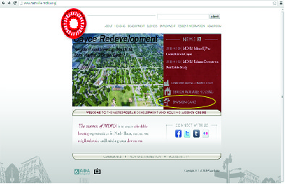
Envision Cayce Contact Info
615-252-8420
envisioncayce@nashville-mdha.org
http://www.nashville-mdha.org/cayce.php

Slide 57
Planning Team
EJP Consulting Group, LLC – Project Lead
Smith Gee Studio - Design
Barge Cauthen & Associates – Engineering and Costing
Duvernay + Brooks – Finance
Urban Blueprint – Community Engagement
Randall Gross/Development Economics – Market Assessment

